Slide 1

Flight Price Prediction
Kuldeep Singh

Slide 2
Table of Contents
Introduction
Analytical Problem Framing
Data Analysis
Assumptions
Machine Learning Models
Results and Conclusion
Limitations and Scope for Future Work

Slide 3
Introduction
Airline companies use complex algorithms to calculate flight prices given various conditions present at that particular time. These methods take financial, marketing, and various social factors into account to predict flight prices.
Nowadays, the number of people using flights has increased significantly. It is difficult for airlines to maintain prices since prices change dynamically due to different conditions. That’s why we will try to use machine learning to solve this problem. This can help airlines by predicting what prices they can maintain. It can also help customers to predict future flight prices and plan their journey accordingly.
Data was collected from yatra.com for the period of two weeks for economy, premium and business classes.

Slide 4
Analytical Problem Framing
In this analysis, we will be predicting the flight price for various class in domestic flights
Using this as a base, I have collected the data from yatra.com websites. The data was collected the period of three weeks. I have included various features like flight class, duration, number of stops between destination and so on
Once the data is collected, we will extract features from it, the data will be cleaned and pre-processed with all the necessary tools and the same will be used to build machine learning models in order to predict the price of the same

Slide 5
Data Analysis
The dataset has 3148 rows and 10 columns. Using this dataset we will be training the Machine Learning models on 80% of the data and the models will be tested on 20% data.
There are no missing values in the dataset. However, we can expect outliers and un-realistic values for certain variables
I’m extracting features like day of week, sessions in a day (i.e., morning, afternoon, night and so on), month, day, departure hour, departure minute and total duration in minutes.

Slide 6
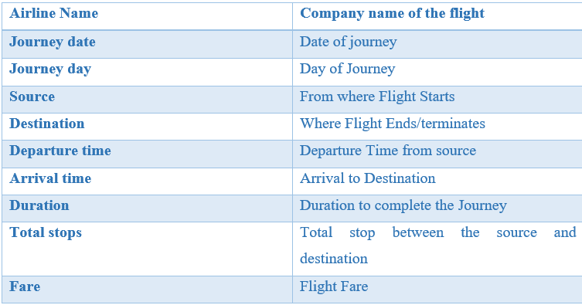
There are no null values in the dataset and there are some categorical data in the dataset. Below are the final features we gathered post feature extraction from the actual collected data

Slide 7
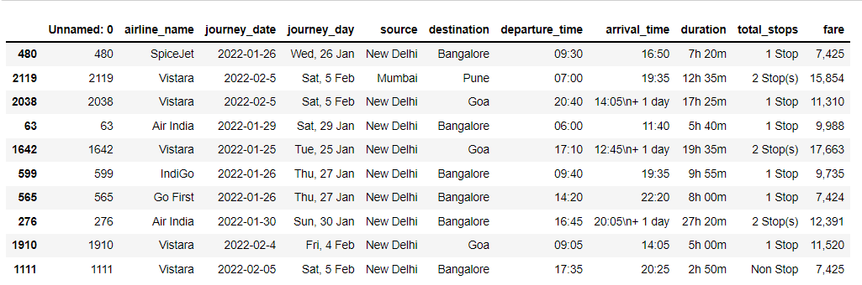
Looking at the glimpse of the dataset and proceeding with visualizing the relationship between the variables

Slide 8
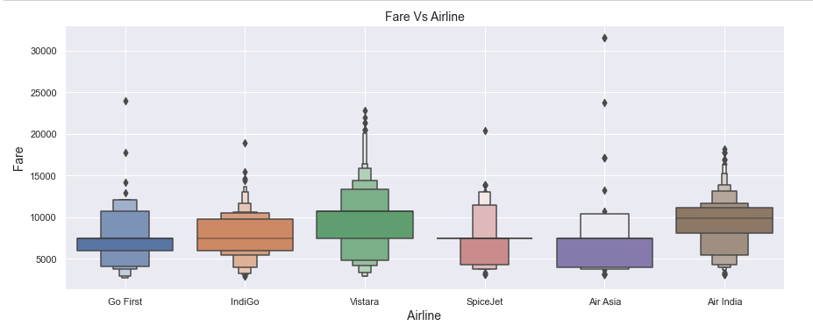
We can proceed with finding the correlation of the dependent variable with the independent variables. Let’s look at some of the highly correlated variables
Airlines v/s price
Vistara and has the highest price and the lowest is Go First.

Slide 9
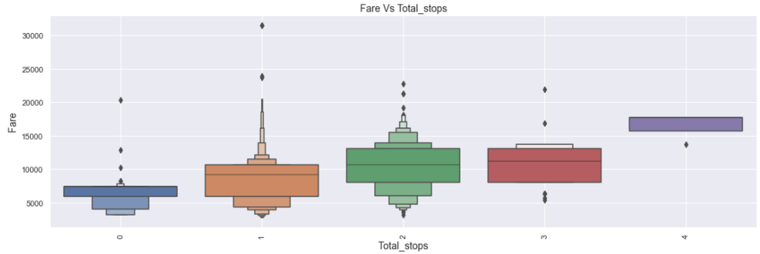
Stops v/s price
We can see flights with zero stops are having very less price, the fare increase as the stops increase.

Slide 10
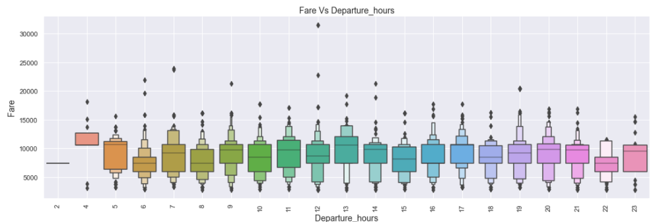
Departure hour v/s price
The flight price were cheaper between 10 PM to 4 AM and costlier during other time periods in a day

Slide 11
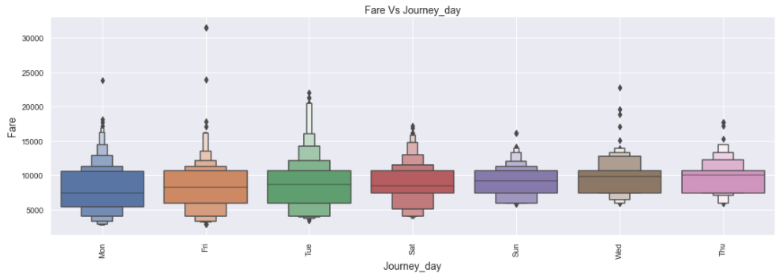
Day of week v/s price
The flight charges were costlier during Wednesday, thuresday and cheaper on Mondays

Slide 12
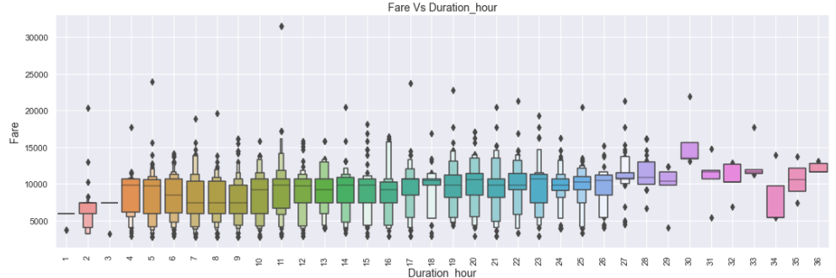
Duration in Hours v/s price
The duration of the flight is also related to the price, here when the flight duration increases, the price also increases

Slide 13
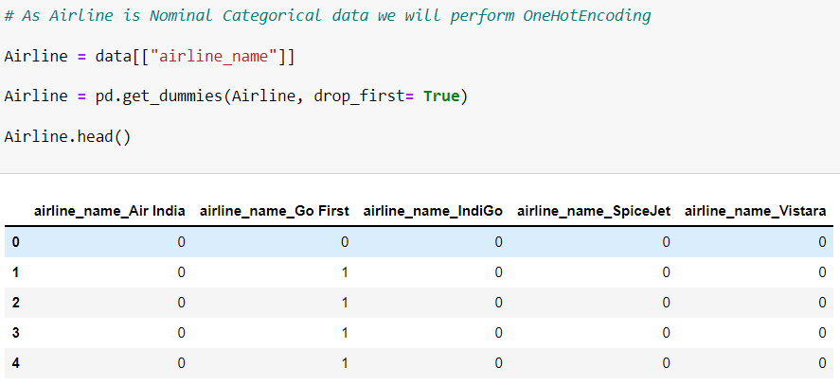
Before proceeding with the further steps, I’m encoding the categorical variables so that I can find the correlation coefficients and identify the multicollinearity issue with the dataset.
In order to perform encoding, I’m using onehot encoder to convert categorical variables into numeric variables.

Slide 14
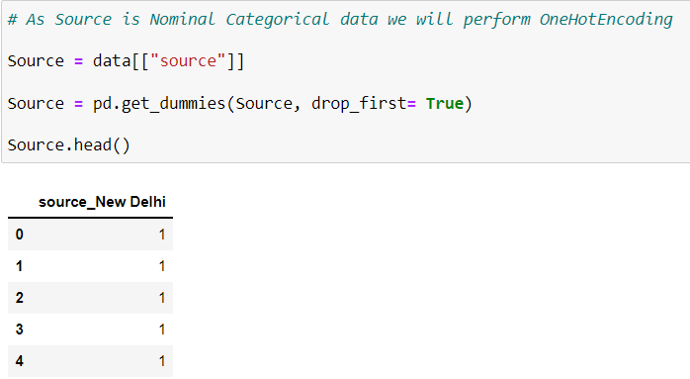
Encoding Source

Slide 15
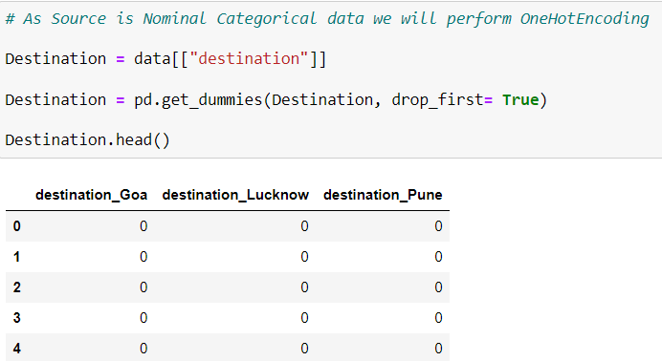
Encoding Source

Slide 16
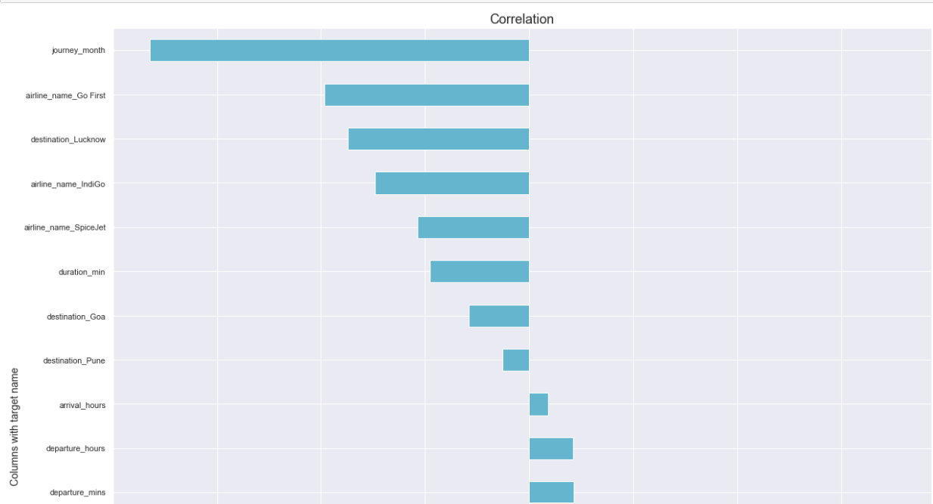
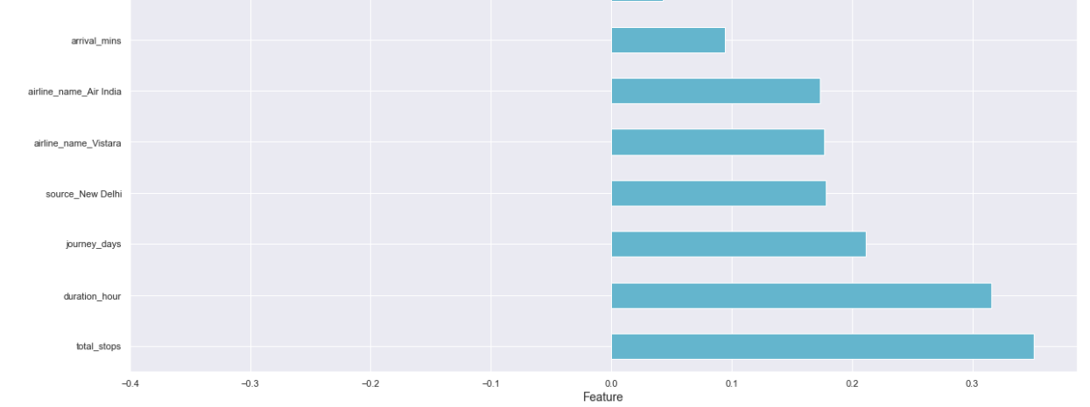
Now that we have analyzed the correlation between the dependent and independent variables, we can move forward in analyzing the multi-collinearity.

Slide 17
Assumptions
We assume that all the variables follow normal distribution
The multi-collinearity in the dataset will not affect the prediction.

Slide 18
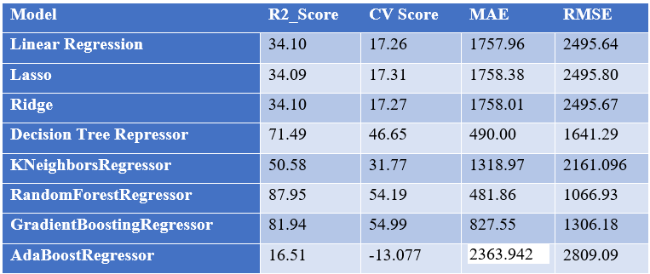
Machine Learning Models

Slide 19
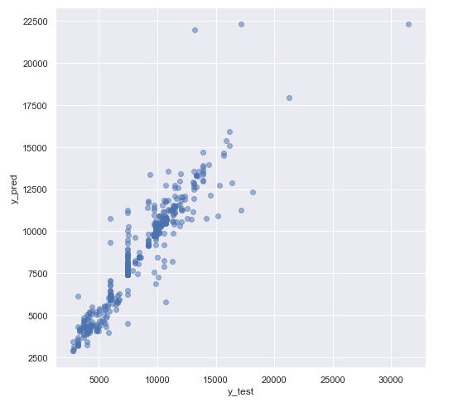
As per the previous slide the chosen best model for the dataset is Random Forest Regressor therefore performing Hyper Parameter Tuning on the same.
Below is the plot for Actual and Predicted sale price for Hyper Tuned Random Forest Regressor

Slide 20
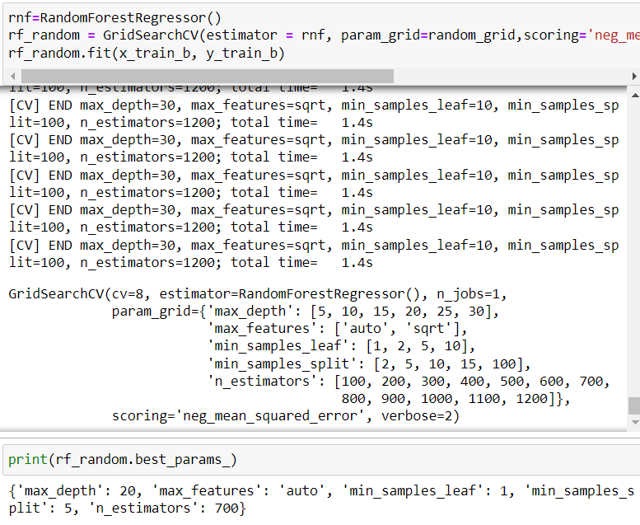
Results and Conclusion
We have successfully built a model using multiple models, we found that the Random Forest Regressor model and hyper parameter tuning on the same Performing well .

Slide 21
Limitations of this work and Scope for Future Work.
Due to unrealistic flight prices in the website, the error might be higher for certain regions and duration of flight. For example, We can see that Delhi to Goa flights are in the range of 7000 to 8000 and for the same date and flight there are prices greater than 10000
Due to this there might be good amount of difference than expected in the future prediction in a new dataset. Other than these above limitations, I couldn’t find more scope for improvement

Slide 22


